Slide 1


Skin Cancer Detection Application
Sprint 2 Presentation:
ML Model
Content Database
Backend API Calls

Slide 2
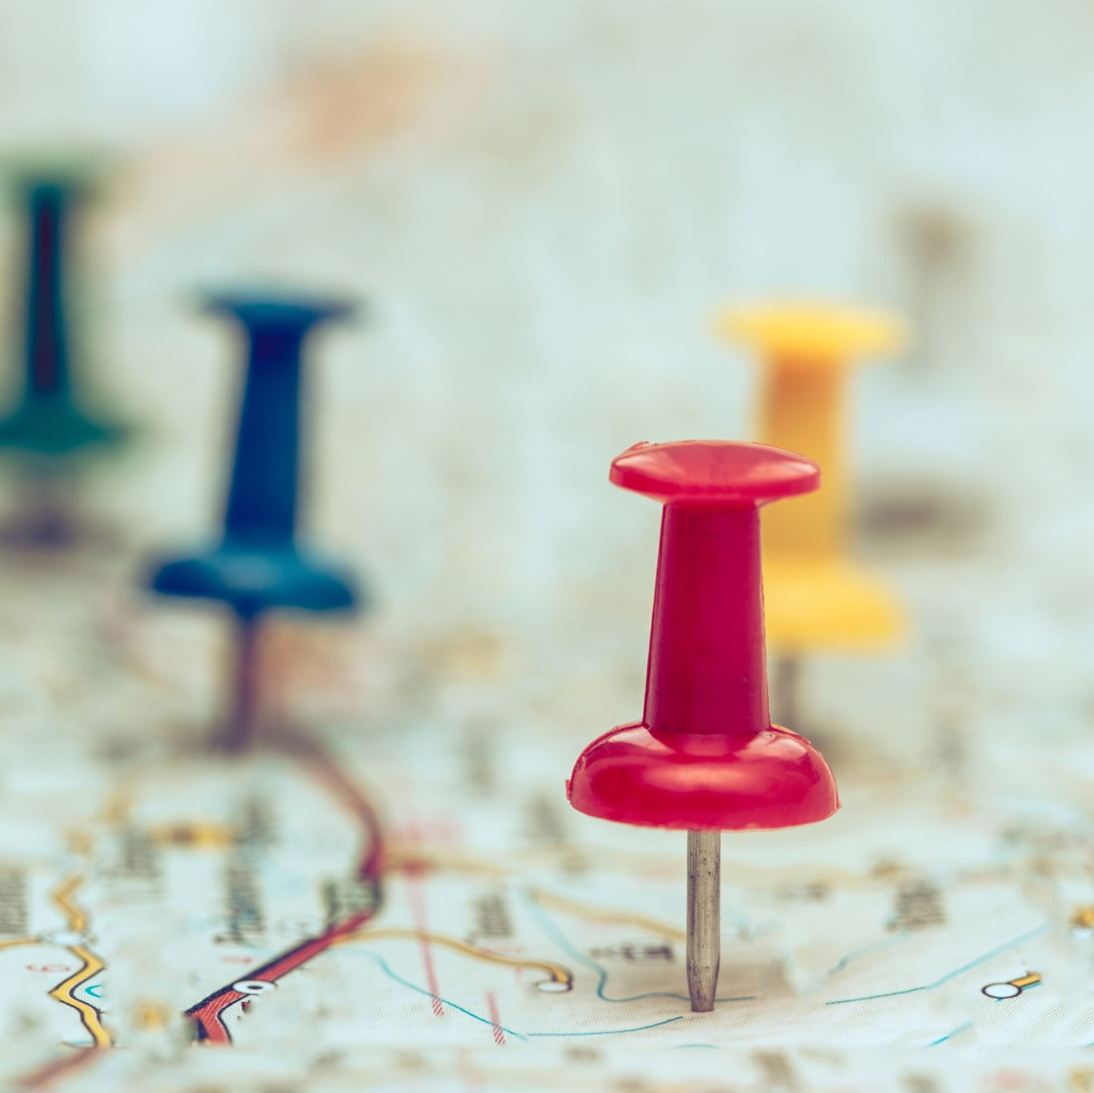
Team Workspaces:
Trello: https://trello.com/w/skincancerdetectionteam
GitHub: https://github.com/johnsmillie-portfolio/Skin-Cancer-Detection-App

Slide 3
Completed Stories
Story:
Story:

Slide 4
Backlog Management
Epics:
Epic 1 I am a user who wishes to upload an image to detect skin cancer so that I receive information about my condition
Epic 2 I am a user who wishes to use their mobile device to take a photo of skin for skin cancer detection
Stories:
Story 1 As a developer, I need a sequence to preprocess images (resize, normalize), so they are formatted correctly for the ML model
Story 2 As a backend developer, I need to provide backend calls that execute the ML model, so that the frontend can make the proper calls to the backend.
Story 3 As a user, I want to upload a clear image of the affected skin area so that I can receive an instant diagnosis.
Story 4 As a user, I want to download the analysis results, so I can share them with my health team
Story 5 As a user, I want to view or download the analysis results, so I can share them with my health team

Slide 5
Release Plan: Estimated Velocity = 25
Sprint 3:
Item 1 Backend API/event processor initialized and pingable
Item 2 Establish a preprocessing tool to format the user-loaded image for the ML model
Item 3 Backend responds to image event call by preprocessing the image
Item 4 Backend executes the ML model with the preprocessed image
Item 4 Responsive frontend renders with option to upload a photo
Item 5 An image can be uploaded from the frontend
Item 6 Frontend calls the backend API with the uploaded image
Sprint 4:
Item 1 Backend returns simple result after ML model execution
Item 2 Validate the end-to-end workflow (image upload → analysis → results).
Item 3 Backend content management for results information to be dynamically displayed with results
Item 4 Backend serves content to the front end along with the results
Item 5 Front end responds dynamically to content with information

Slide 6
Additional Stories
As a user, I desire a fast response, so that I receive real-time feedback about my image
01
As a user, I would appreciate a visualization tool to show model confidence in predictions, so that I am thoroughly informed
02
As a user, I want to take a picture with my mobile device, so the image can be used for a skin cancer diagnosis
03
As a user, I need to trust that the content provided with the results is up-to-date, so they are useful to my diagnosis
04

Slide 7
Technology Stack: MERN
Frontend:
React.js / React Native
Backend
Express.js / MongoDB
ML
Image Processing
Keras
CI/CD
GitHub Actions / Docker / Vercel
TensorFlow / Python

Slide 8
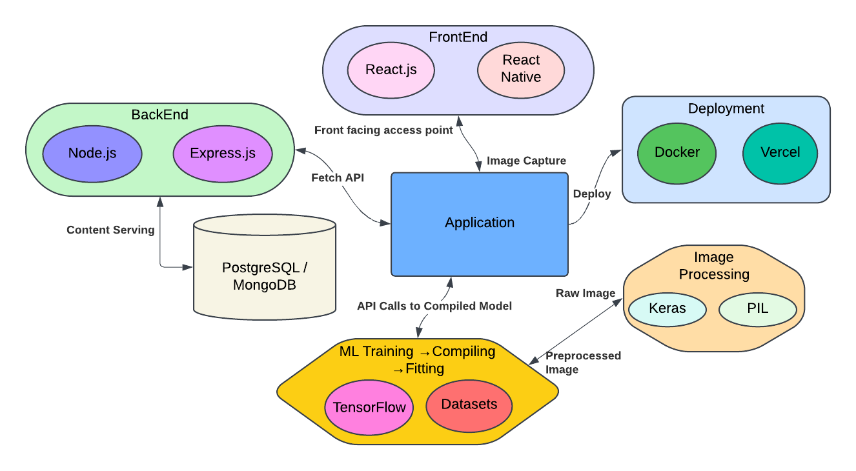
Context Diagram

Slide 9
Sprint Retrospective

